Slide 1
Web Application Frameworks for Enterprise Development
Libraries, Patterns and Techniques to Assist in the Creation of Maintainable Enterprise Applications Using ASP.NET

Slide 2
Presenter = Dave; Presenter.Details();
David Rogers
.NET Developer for 8 years (still learning)
Web: http://davidrogers.id.au
Blog: http://davidrogers.id.au/wp

Slide 3
Intention of Presentation
Everyone has a View/Opinion.
There’s no 1 size fits all architecture. E.g. I’m not engineering for performance
Techniques and patterns which I use and have found helpful (and dare I say successful) in writing maintainable code.
Attempt to comply with SOLID principles.
Code-centric. Guide through implementation via an example app.

Slide 4
Community Mentors
Jimmy Bogard
https://jimmybogard.com/
https://lostechies.com/jimmybogard/
Steven van Deursen
http://www.cuttingedge.it/blogs/steven/

Slide 5
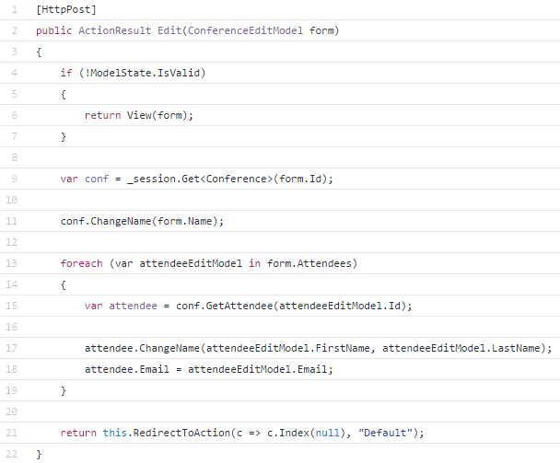
ModelState Validation
We're validating the integrity of the HTTP request model
This is a cross-cutting concern and we don't need to be polluting all our POST actions with:
if(ModelState.IsValid)
Use a custom ActionFilter to push that responsibility to our framework to do it for us.

Slide 6
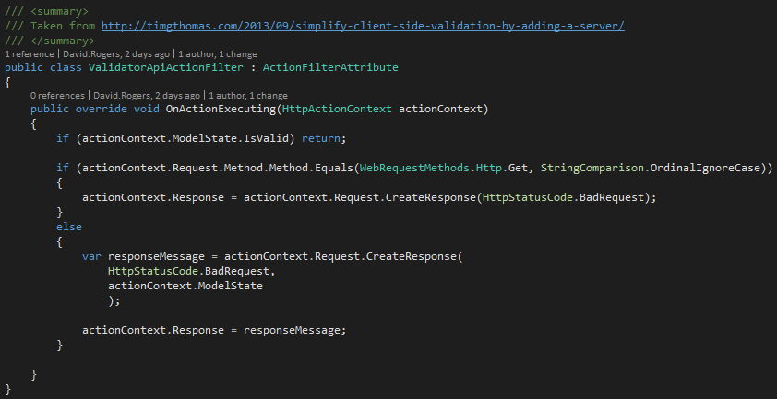

Custom API Action Filter
Do this in your WebAPIConfig class ->

Slide 7
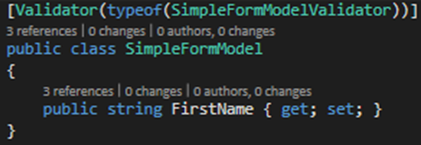
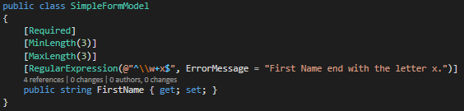
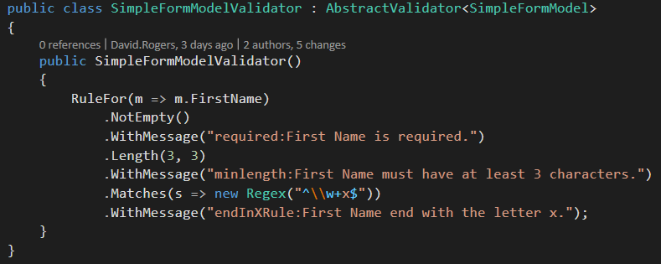
Fluent Validation Externalises Validation
Fluent Validation bolts onto ModelState
Much cleaner than

Slide 8
IOC with SimpleInjector

Slide 9
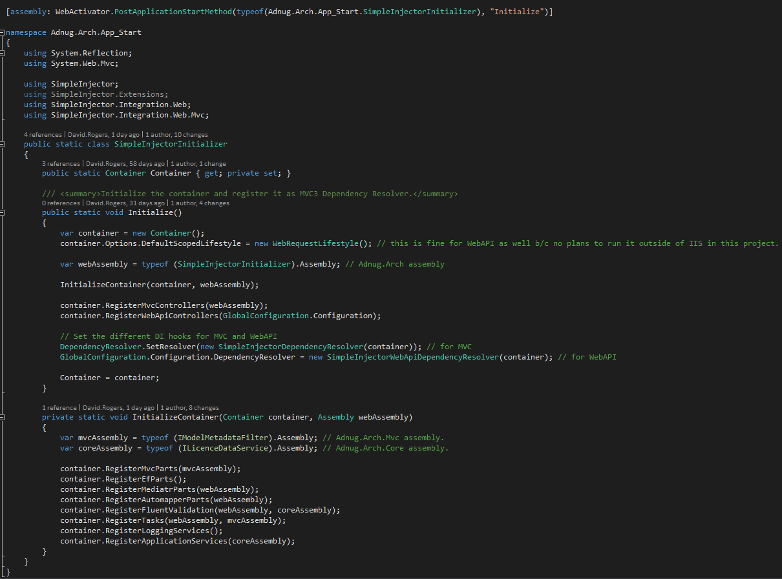
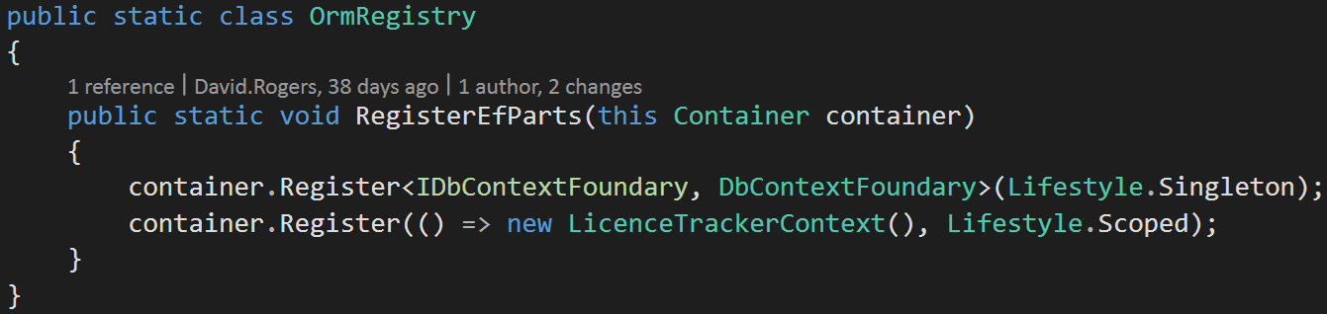
Dependency Injection
Composition Root

Slide 10
MediatR

Slide 11

Mediatr
Command with Data and Behaviour
var command = new MoveCustomerCommand
{
CustomerId = customerId,
NewAddress = address
};
command.Execute();
This design can be improved!
In memory message bus (GOF Mediator Pattern)
Keeps our controllers clean
Also separates the
object; and
handler which will execute logic upon said object
Use command/command Handlers and Queries/Query Handlers – Mediatr does not distinguish between them. We can do so with naming and convention.

Slide 12
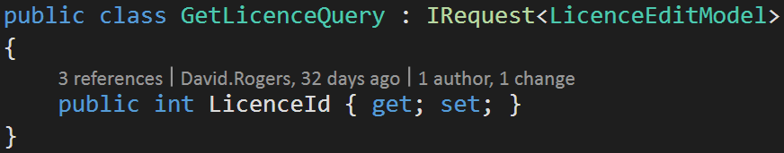
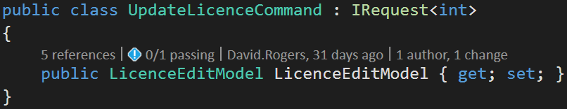
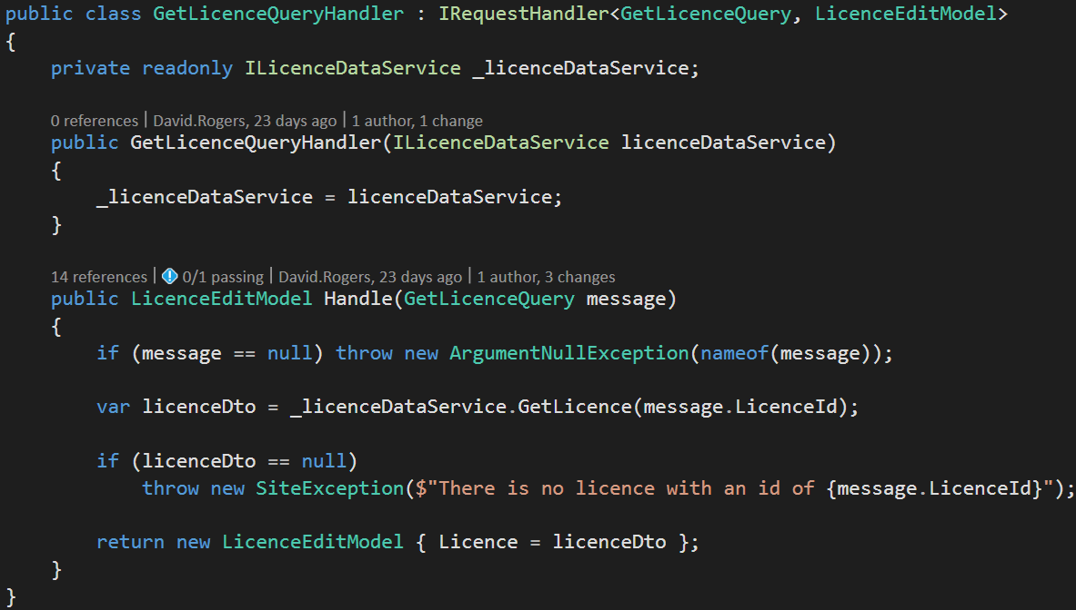
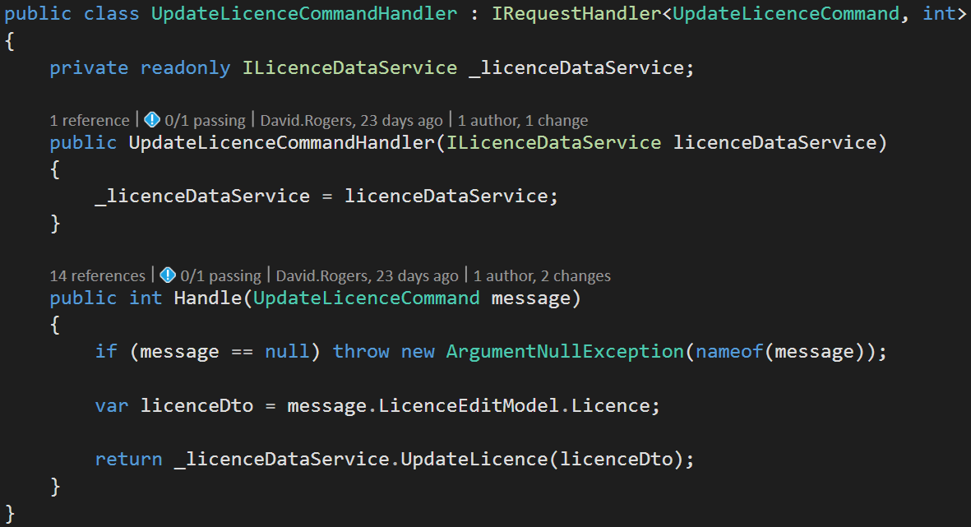
Commands and Queries
Query Side
Command Side

Slide 13
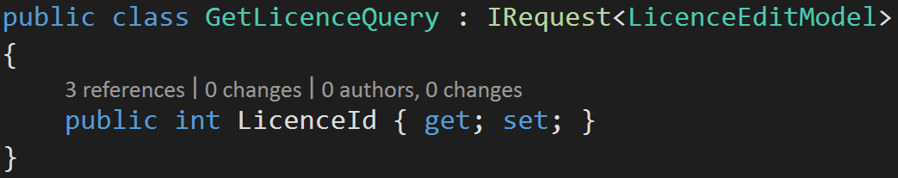
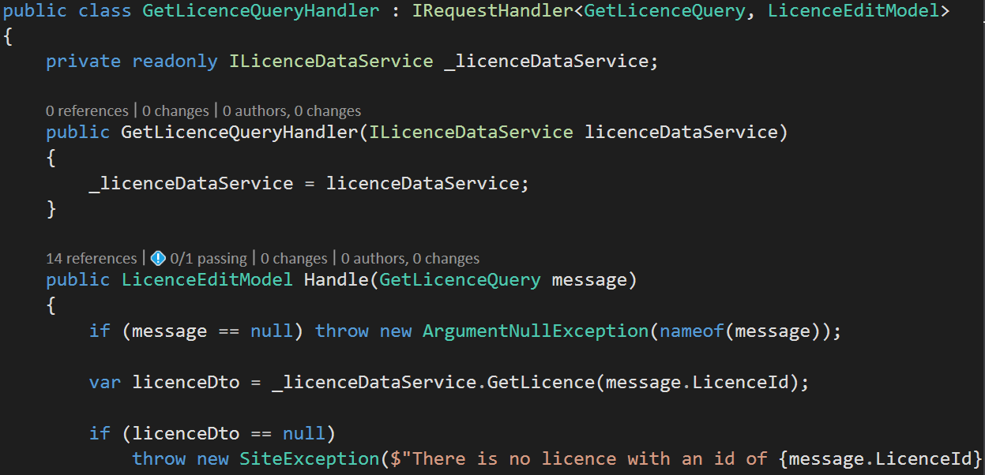
Using Mediatr
First, create your query (or command)
Create the concomitant handler
Then, in your controller action
_mediator.Send(new GetLicenceQuery{ LicenceId = id.Value })
IoC config makes this possible (go to demo).
Example of new API
Notes:
The payload Type determines which Handler will receive the message!

Slide 14
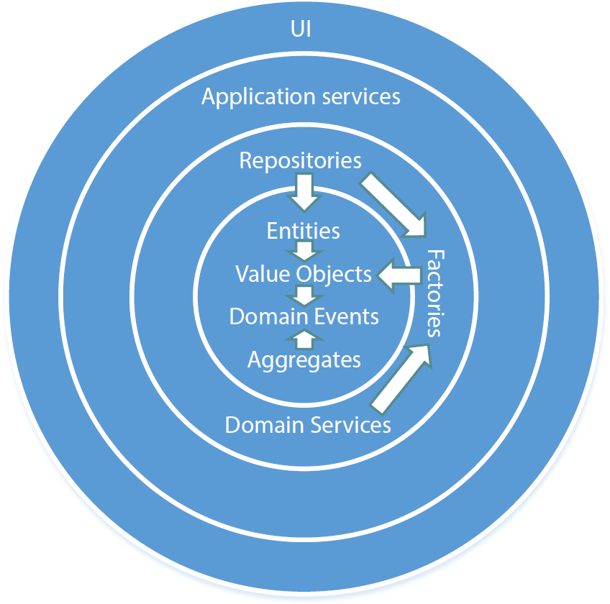
Decorators
Another GOF pattern
Allow us to implement an onion architecture for Http requests
Need to configure DI container to wrap decorated objects so they get invoked after the decorating object
Diagram taken from Pluralsight course Domain-Driven Design in Practice

Slide 15
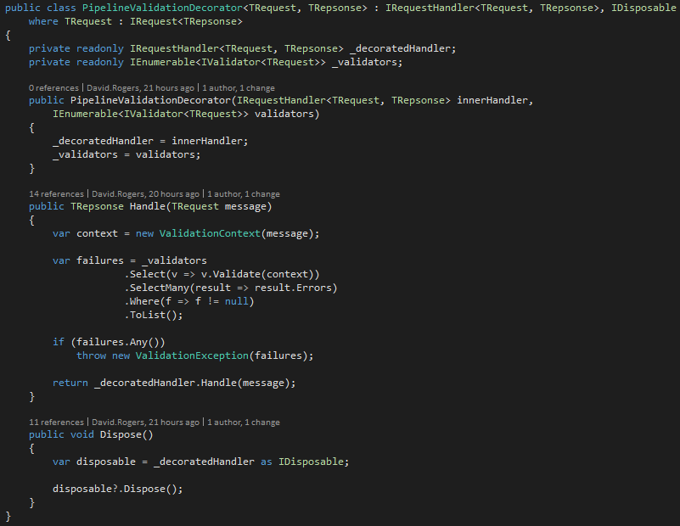
Example Decorator

Slide 16
Automapper

Slide 17
Automapper
A convention-based object-object mapper. 100% organic and gluten-free. (From Website)
Map domain objects to DTOs.
Combination of convention and up-front configuration
Can use reflection, in combination with some marker interfaces, to ease the maintenance burden – IMapFrom<T> and IHaveCustomMappings<T>

Slide 18
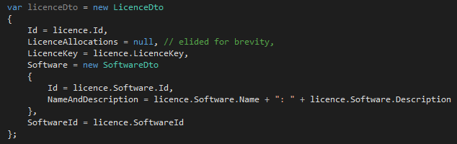
Automapper – Reason for Being
Manual
Automapper

Slide 19
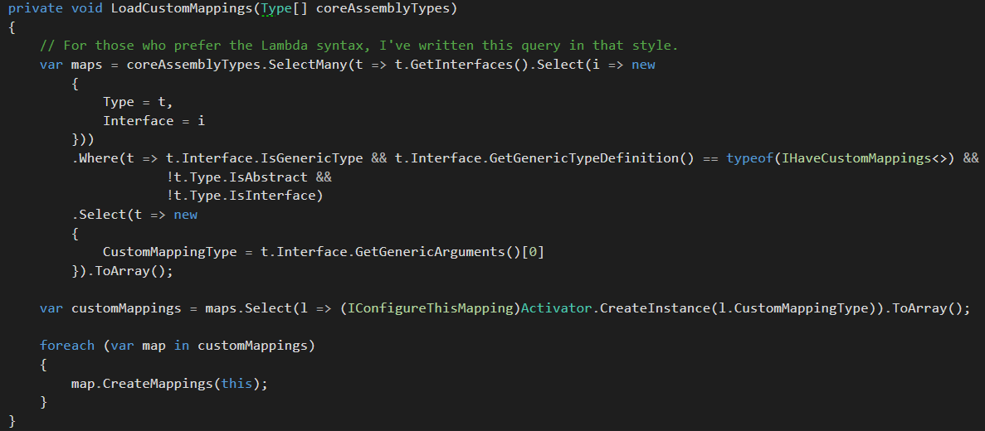
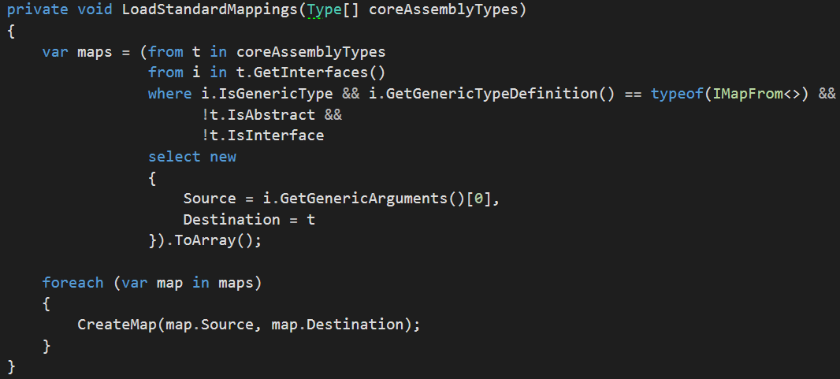
Automapper Configuration
Manual Way
Automated Way
public class BookCoverInitializer : MappingBase, IMappingInitializer
{
public BookCoverInitializer(Profile profile) : base(profile)
{
}
public void Initialize()
{
Profile.CreateMap<Model.BookCover, UiModel.Models.BookCover>();
}
}
public class ViewModelMappings : MappingBase, IMappingInitializer
{
public ViewModelMappings(Profile profile)
: base(profile)
{
}
public void Initialize()
{
// Initialize all individual mappings here
new BookCoverInitializer(Profile).Initialize();
}
}
new CommentInitializer(Profile).Initialize();
}
new PublisherInitializer(Profile).Initialize();
new BookInitializer(Profile).Initialize();
}
new LendingInitializer(Profile).Initialize();
new PersonInitializer(Profile).Initialize();
}

Slide 20
Some General Bits

Slide 21
Extending the User Object
ASP.NET gives access to a User property which implements IPrincipal
We can create an abstraction which gives us much richer info than IPrincipal

Slide 22
Logging Adapter
Don’t need to use a façade with proxies etc.
Create an interface with the least contract to Implement
Extend the Interface with extension methods
Configure DI container to inject the relevant logger

Slide 23
Misc Bits and Bobs
Notification System
Parent Controller
Custom JSON.NET ActionResult
WebActivator

Slide 24
Libraries
Fluent Validation
Mediatr
Automapper
Log4net
Simple Injector
JSON.NET

Slide 25
References
SOLID Architecture in Slices not Layers - Jimmy Bogard
Fluent Validation for ModelState validation
Build Application Framework ASPDOTNET MVC 5
Meanwhile... on the command side of my architecture
Meanwhile... on the query side of my architecture

